Slide 1
Gift Data Analysis
Email: iravadwijasri@gmail.com
Dataset: gifts_by_occasion.csv
I Dwijasri
2211CS010223

Slide 2
Introduction
Purpose: To analyze gift trends across different occasions and categories to provide actionable insights.
Scope of Study:
Examine patterns in gifting behavior
Identify popular categories and price ranges
Provide recommendations for businesses and customers
Significance:
Helps e-commerce platforms optimize inventory and marketing strategies
Assists customers in choosing popular and suitable gifts Visual: A diagram showing “Data → Analysis → Insights → Recommendations”

Slide 3
Analysis of Data
Dataset Size: ~1200 records
Key Features:
The dataset contains gift records with attributes such as occasion, gift name, category, price (USD), giver and receiver age, relationship, purchase channel, country, date, and gift message.
Observations: Dataset is moderately clean, suitable for exploratory analysis

Slide 4
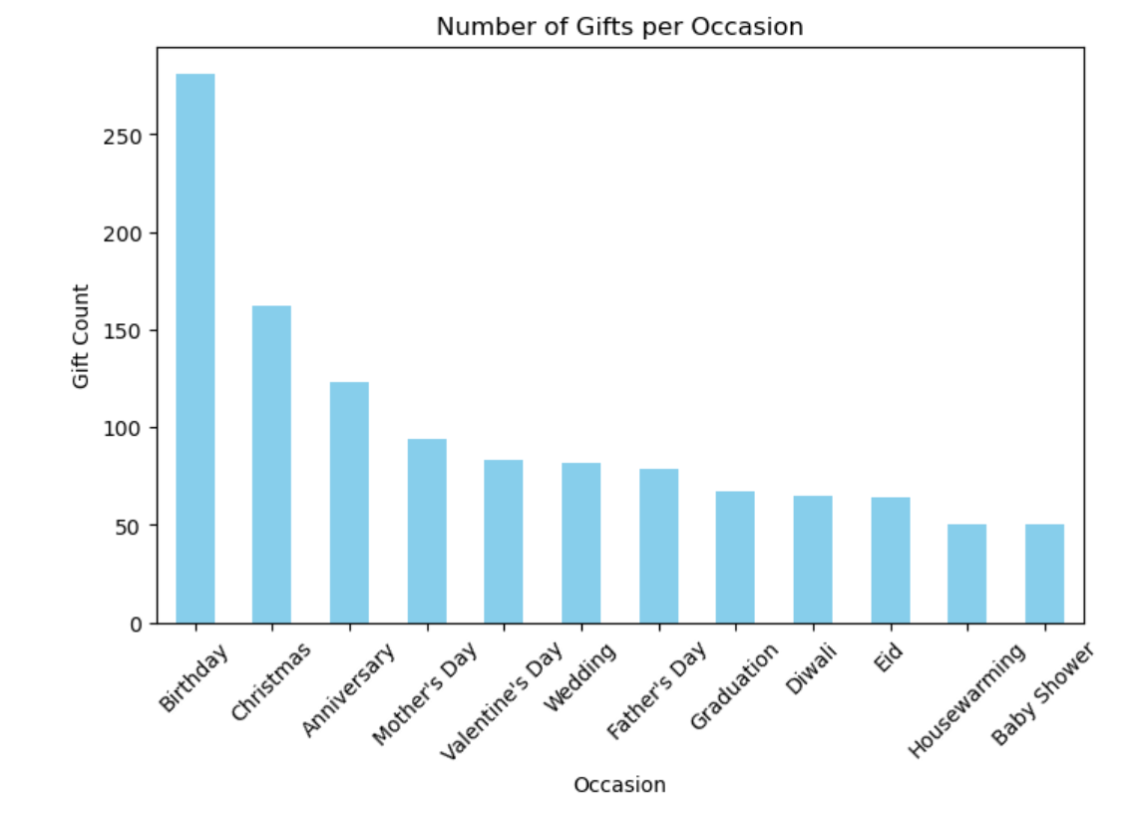
Plot 1

Slide 5
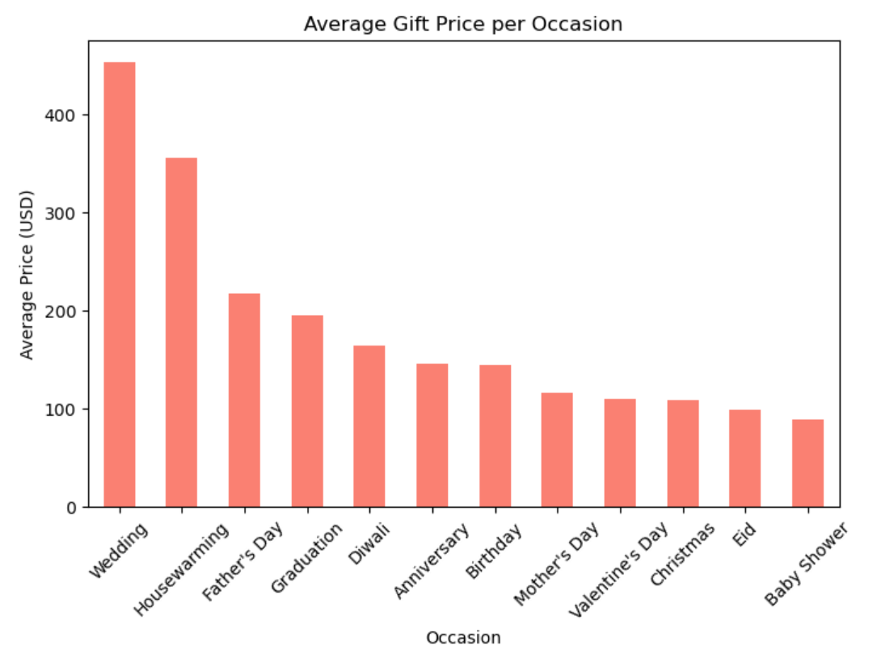
Plot 2

Slide 6
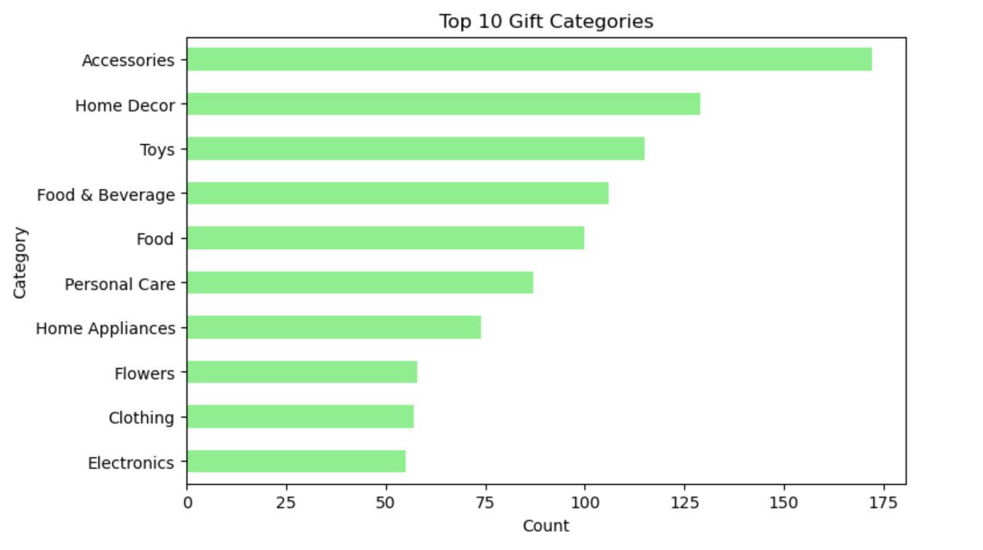
Plot 3

Slide 7
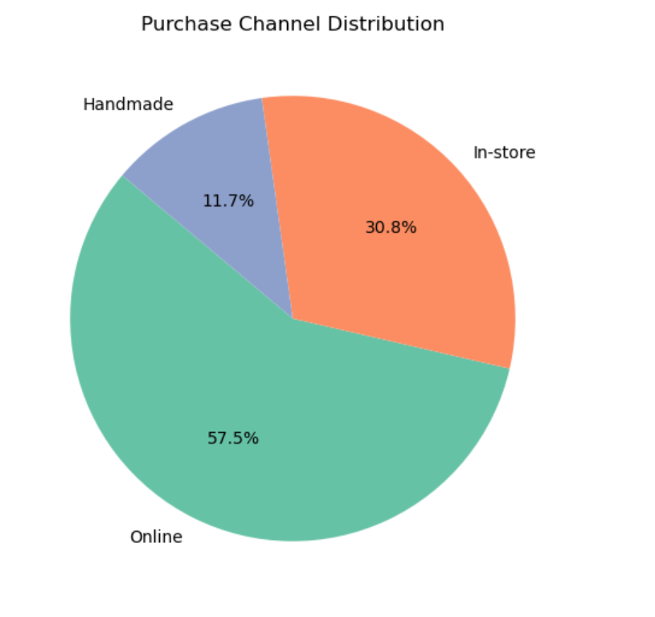
Plot 4

Slide 8
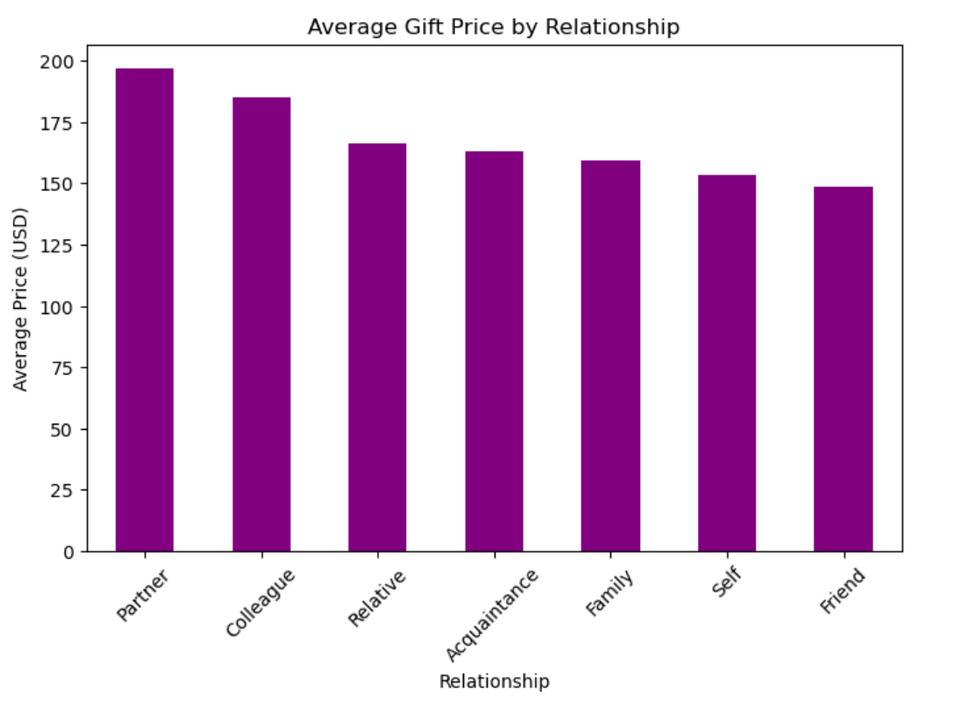
Plot 5

Slide 9
Data Observation
Most gifts are given for Birthdays and Christmas, and Accessories and Home Decor are top categories. Online is the most popular purchase channel.
Weddings and Housewarmings see the highest average gift prices. There are interesting outliers and cultural trends visible in the data.

